Slide 1
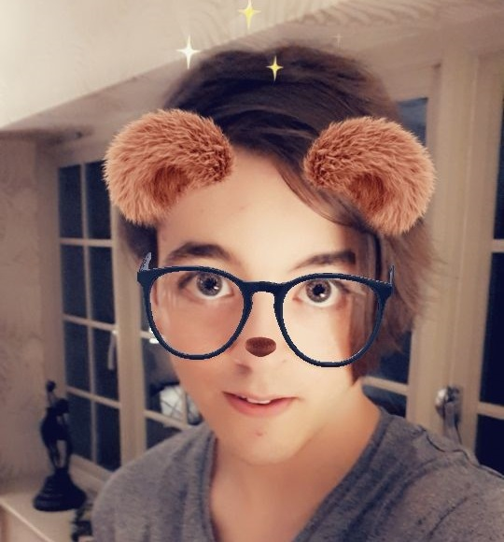


My experience in the Games Development Industry
Anthony “Fydar” Marmont
(they/them)
@Fydarus
Fydar
Notes:
Hiya,
I'm Anthony. My friends call my Fydar.
I’d like to talk about my experience of the Games Development Industry. I'd like to show you around the studio, and talk about my life as a programmer.
A lot of people who are considering Games Development as a career have only heard about the “grind” and the “crunch”.
I don’t want this to scare you away. I want to show you my experience.

Slide 2



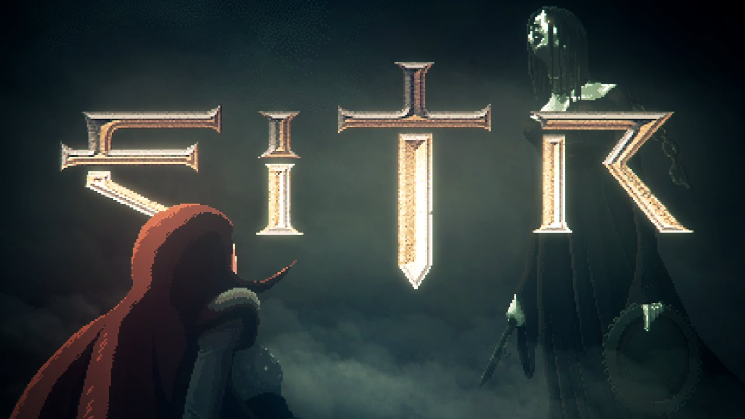
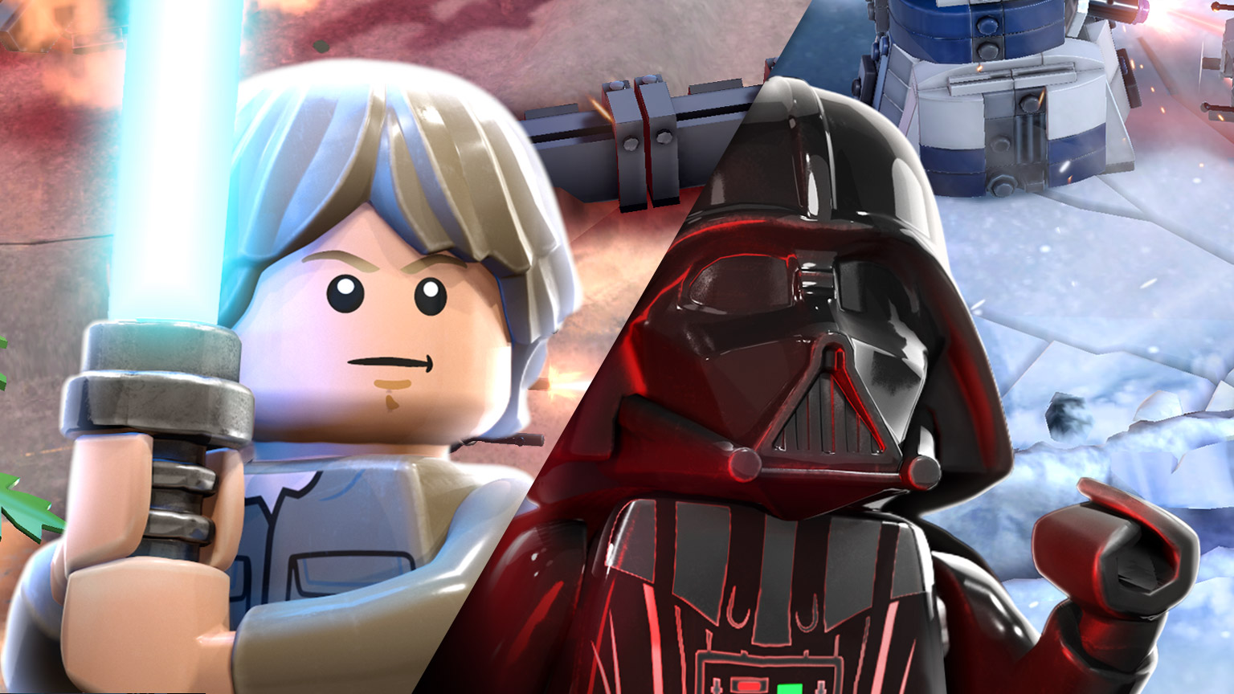

Devolver Digital
12 months
3 person team
TT Odyssey
2 years, 3 months
30 person studio
Cloud Imperium Games
1 year, 3 months
700 person studio
Notes:
People are often curious about my life in games dev, and I hope you are too.
I started doing freelancing for Devolver Digital on an indie title called ‘Eitr’.
Freelance work lead me to my first in-studio job at TT Odyssey, working on a ‘LEGO Star Wars’ mobile game. For those who don’t already know, TT Games make the LEGO games.
I’m now at Cloud Imperium Games, working on ‘Star Citizen’.
I want to tell you what my day-to-day life in games development is like; but unfortunately nothing is day-to-day working at Cloud Imperium Games. I joined in the pandemic; so everything has really been upside down.
I’ll primarily be focusing on my experience at TT Odyssey. I think it will be more applicable to the industry at large.
I’m often told by my colleagues and directors that my path career unusual. And it is.
Not going to University has left me without a degree; and this has been a massive cause for career anxiety for me.
Career anxiety sucks!
It’s feeling like you always have to prove yourself.
It’s feeling like you’re an imposter (and you don’t belong in your team).
It’s not knowing where you are going.
But career anxiety is normal.
It’s important to recognise the things that make us feel this way.
And for myself; this drives me.

Slide 3
So, what did you work on at TT Odyssey?
Notes:
What did I work on?

Slide 4
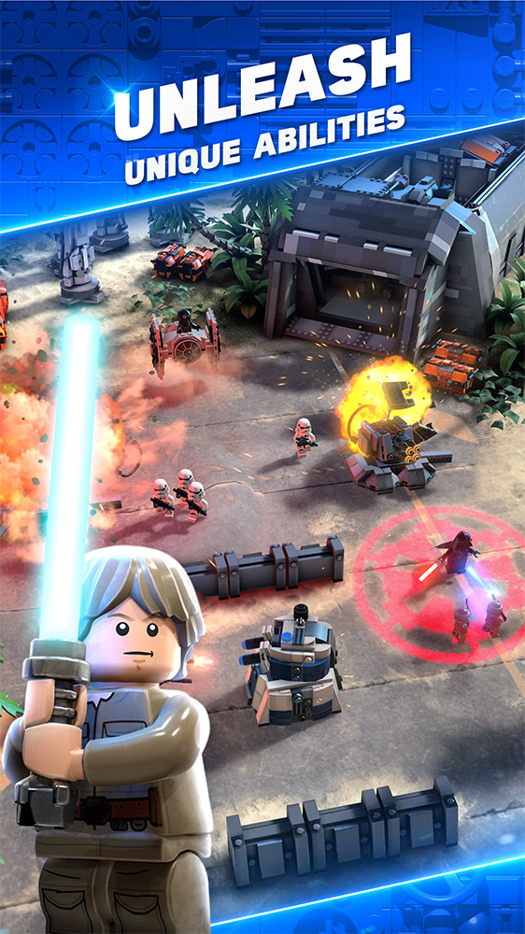
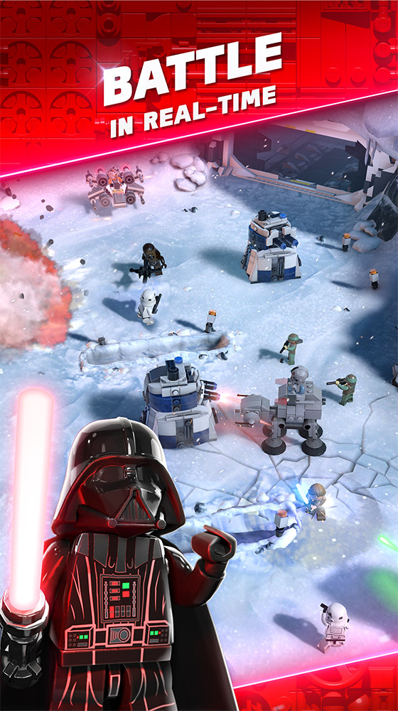
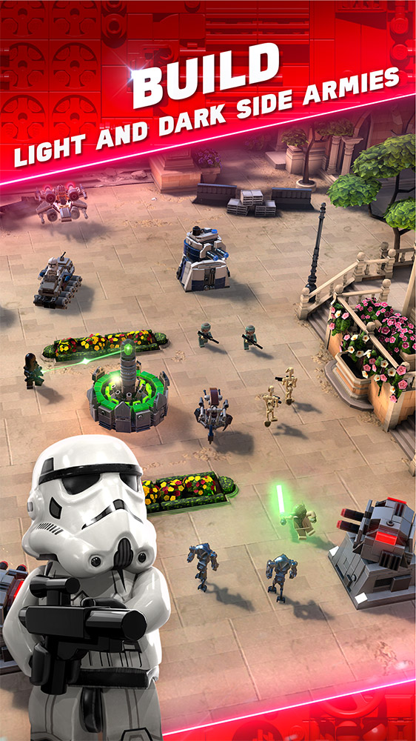
Notes:
This game. It’s called “LEGO Star Wars Battles”.
It’s Clash Royale with LEGO Star Wars Characters.

Slide 5
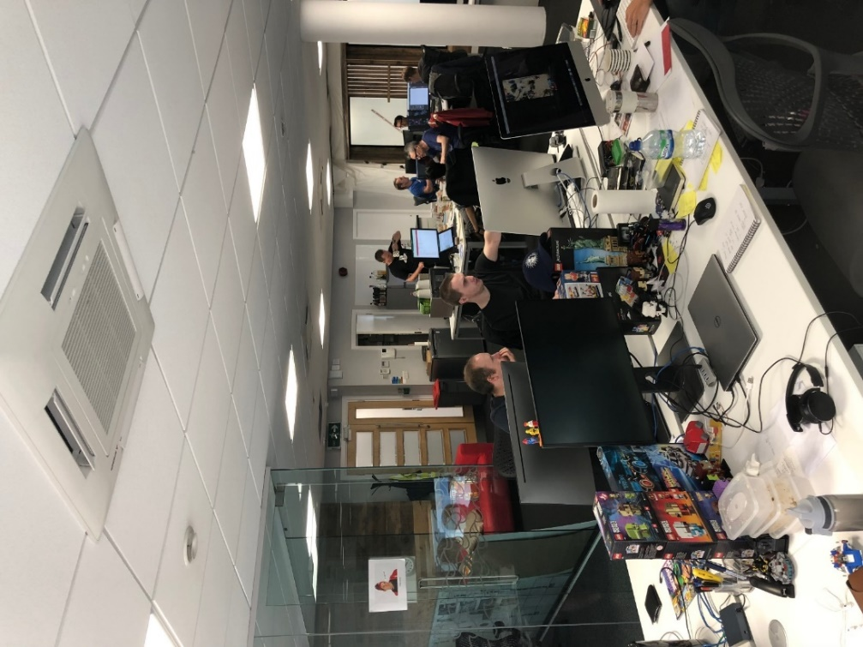
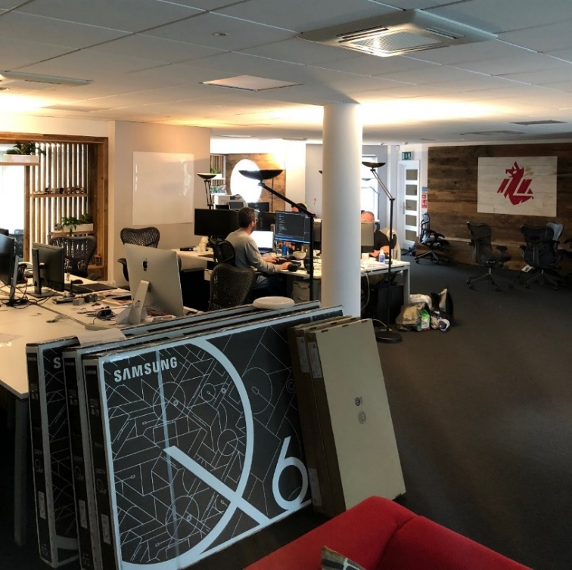
Notes:
So this is where I work. The office looks quite messy in these photos. The whole office was forced into just one half whilst we remodelled. This was when we had to put the microwave and toaster on Matts desk, and if we used both of them at the same time then we would loose hundreds of hours of work as every our floor looses power. I would also toast hot-cross buns for lunch and make everyone jealous. There was also a STRICT no-fish policy. Don’t be that person who microwaves fish.

Slide 6
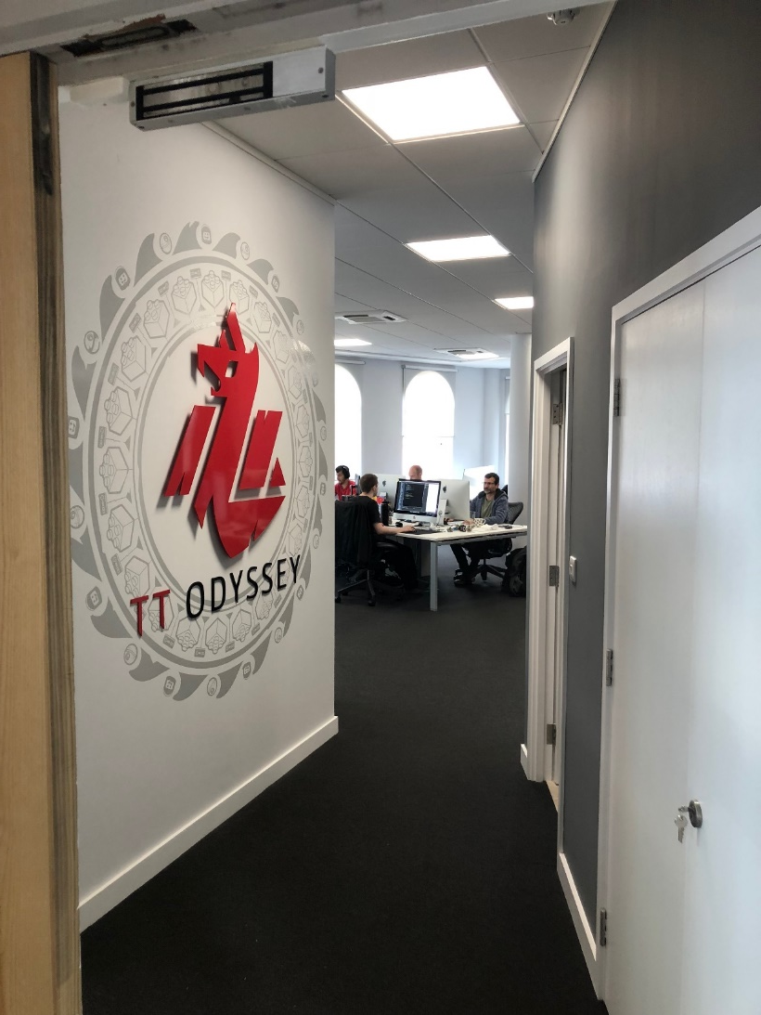
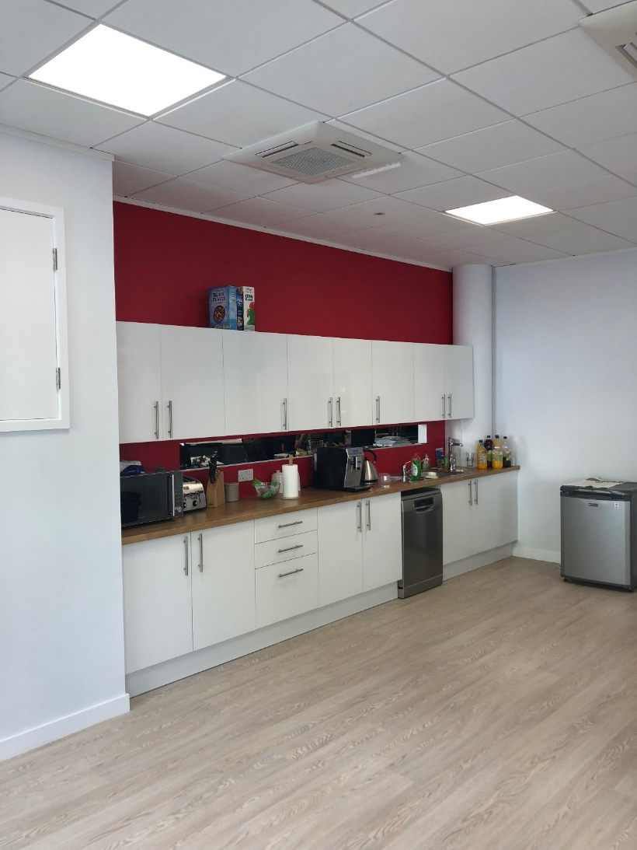
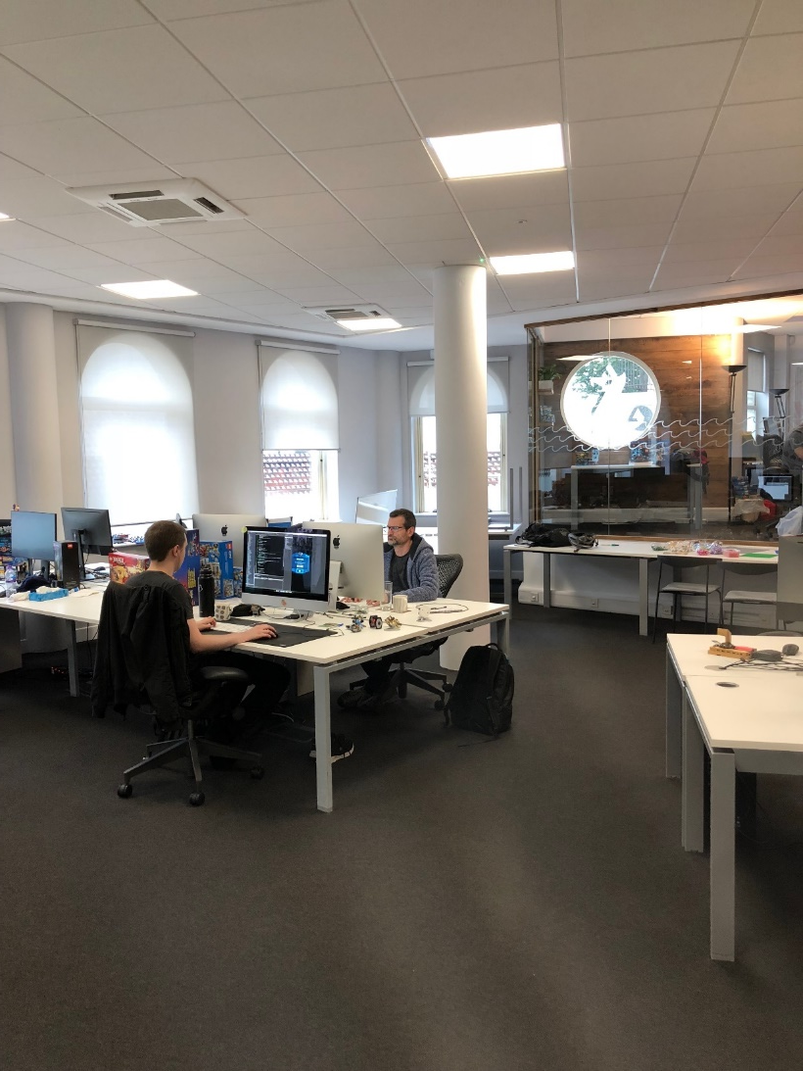
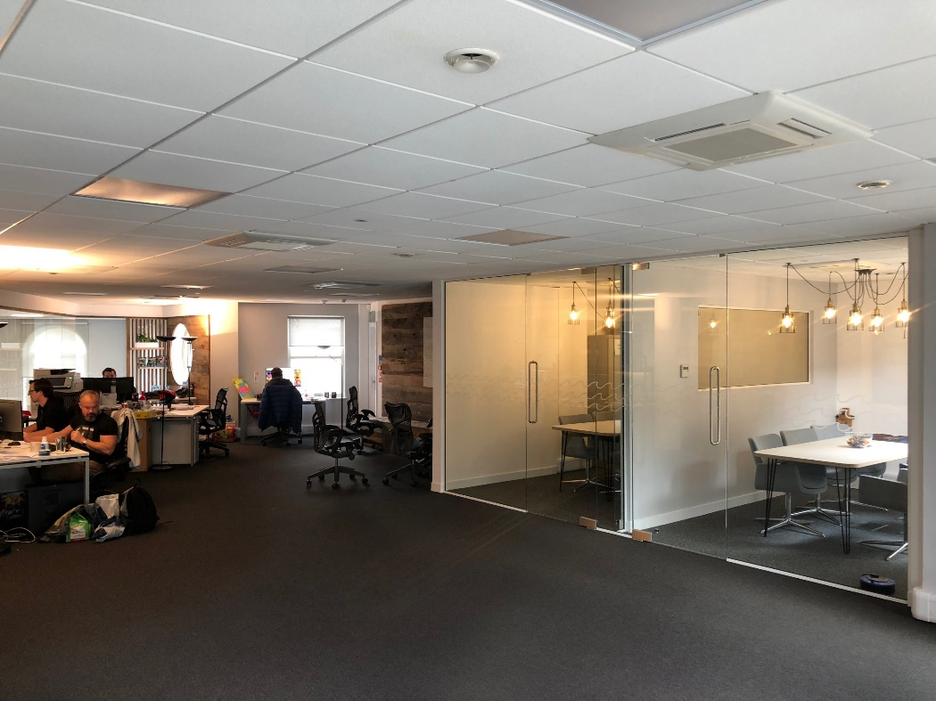
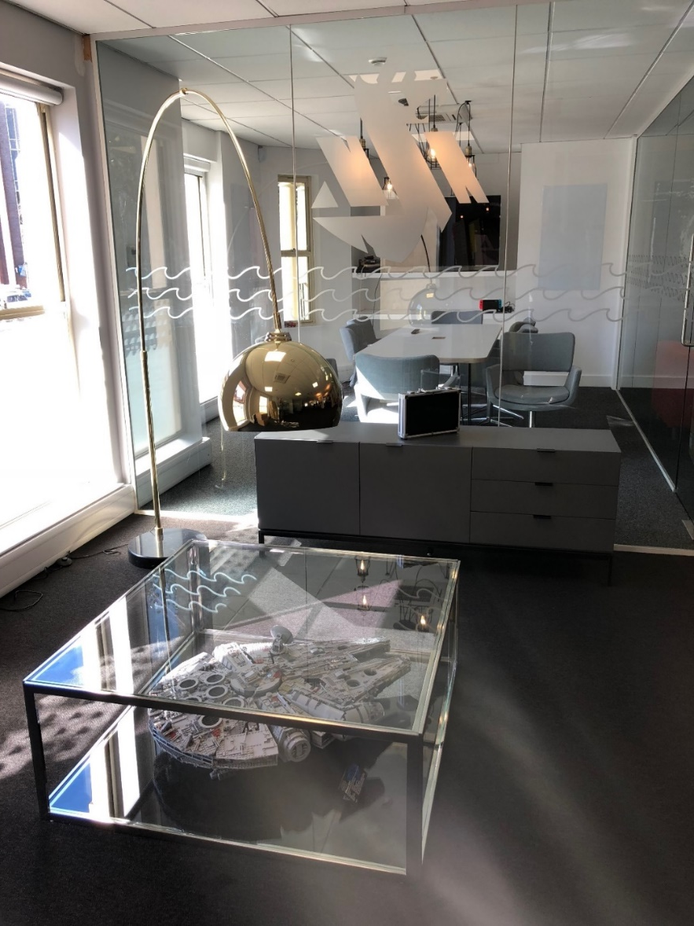
Notes:
Here’s some photos after we finished our remodelling.
We got a nice kitchen, sofa area, and some "Interrogation Rooms”.
The perks of working with LEGO is you get a TON of free LEGO. We would hold quarterly raffles for the free LEGO sets that where sent to the office and the rest we would donate to local charities.
You can see the LEGO millennium flacon under that coffee table.

Slide 7
My Day
Notes:
People are often curious about what my day looks like.
I get a lot of questions about this.
A lot happens at a games development studio, and there is a lot that has to be done before we can get to the work.

Slide 8
Pointing Meetings
We have a lot of meetings…
“How long will this take?”
Happens once a month
Teams estimate how long work will take to complete
If we disagree, we talk more
1/2
1
2
3
5
8
13
20
Notes:
One of the things we need to do as apart of our work is Pointing Meetings.
These happen about once a month.
All of development teams, the gameplay programmers, the 3D Artists, the UI artists, the Animators… Get together in a ‘pointing meeting’.
We then go through a list of futures that our design department want to get us working on in the game. We make sure every item requested by the designers has a point estimate by it by the appropriate teams.
The point estimates are made using a number series that looks like the numbers at the bottom of the slide. Half, 1, 2, 3, 5, 8, 13, 20, 40, etc.. The idea is that we should never have to be more specific that those numbers because we will always have a certain amount of uncertainty when it comes to long term planning and commitments.
If we disagree on the estimates; this is a chance for us to discuss. How about we give it a go now?
I’ve tried to come up with some example problems which overlap with Computer Science and Games Development a lot. I have absolutely no idea what sort of skill levels you are all operating at; sorry if I start to overwhelm anyone.

Slide 9
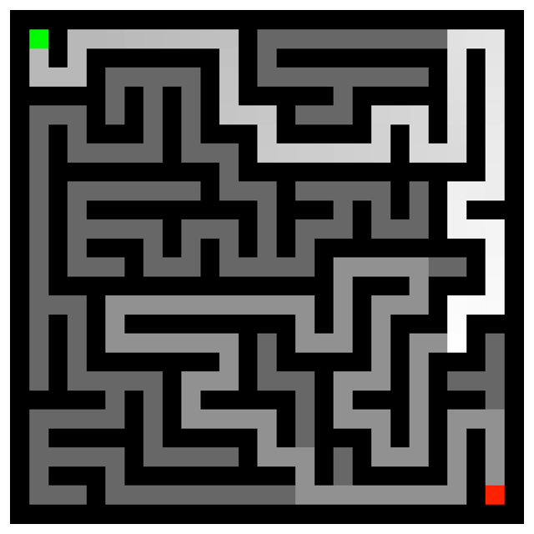
Maze Pathfinding
“How long will this take?”
1/2
1
2
3
day
day
days
days
Gameplay
High-Priority
Notes:
How long do you think this will take?
Maze Pathfinding. There are no wrong answers.
Hands up for half-a-day. Hands up for 1 day. Hands up for 2. And finally, 3.

Slide 10
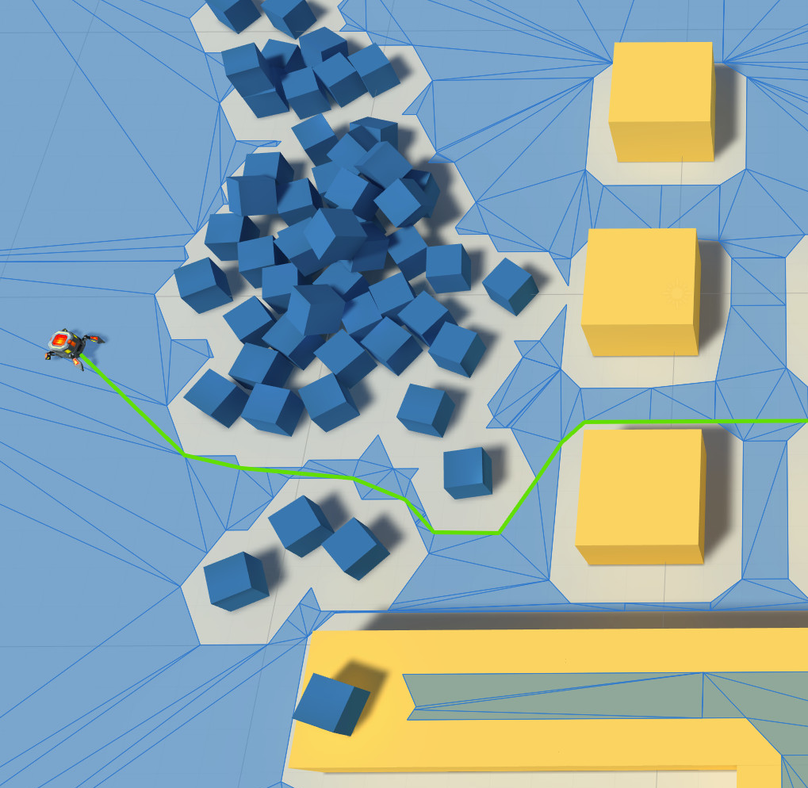
Nav-Mesh Pathfinding
“How long will this take?”
5
8
13
20
days
days
days
days
?
Gameplay
High-Priority
Notes:
How long do you think this will take?
Nav-Mesh Pathfinding. This is taking your Maze Pathfinding up a notch. You now have to find minimal paths across triangles using the same sort of Pathfinding algorithms for triangles instead of a grid.
This is a really game-specific piece of technology, so no worries if you don’t feel comfortable answering. Remember, no no wrong answers.
For this, let’s say you are provided the data by another team. The tools team will be making the Nav-Mesh data, you just have to implement the pathfinding.
5 days, 8 days, 13 days, 20 days. And of course, the answer is.

Slide 11
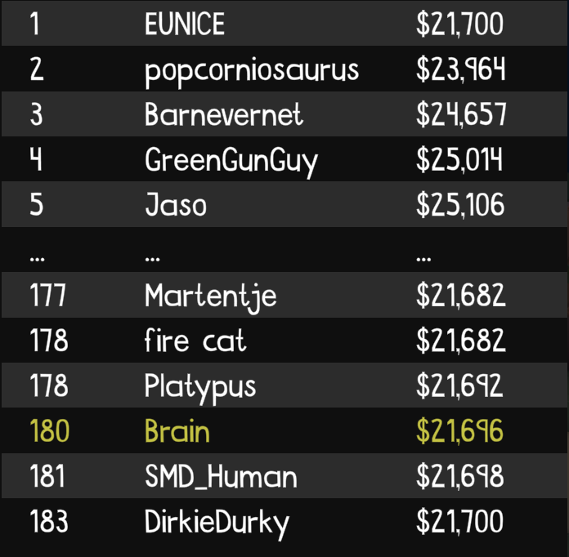
Global Leaderboard
“How long will this take?”
8
13
20
40
days
days
days
days
?
Network
Medium-Priority
Notes:
How long do you think this will take?
A global leaderboard on your Arcade game. Let’s say, top 10,000 players have their score on the Leaderboard for every level in your game. Let’s also say your game has around 1,000 levels.
Your game client is going to have to talk to a game server. That game server is going to have to talk to a database; and relay all that data back to the player.
How long do we think this will take?
I would have loved to have come up with more of these considering how much interaction we got today; but unfortunately that’s the last one.
I can tell you now, that the definitive answer to the question ‘How long will this take?’ is…

Slide 12

Notes:
It depends.
As is the answer to everything in programming.
So, now we know how long everything is going to take, it’s time to put this into sprints.
This happens in our Triage Meetings.

Slide 13
Triage Meetings
We have a lot of meetings…
“What should we work on next?”
Happens once a week
Notes:
Triage is the process of ordering feature work and bugs by their priority.
We divide work up into sprints. Our sprints at TT Odyssey are 2 weeks long. This is pretty standard; but sprints can sometimes be longer or shorter. They can sometimes be one week, they can sometimes be one month.
High-priority work typically comes sooner rather than later. Low priority bugs pretty much always get left to last.

Slide 14
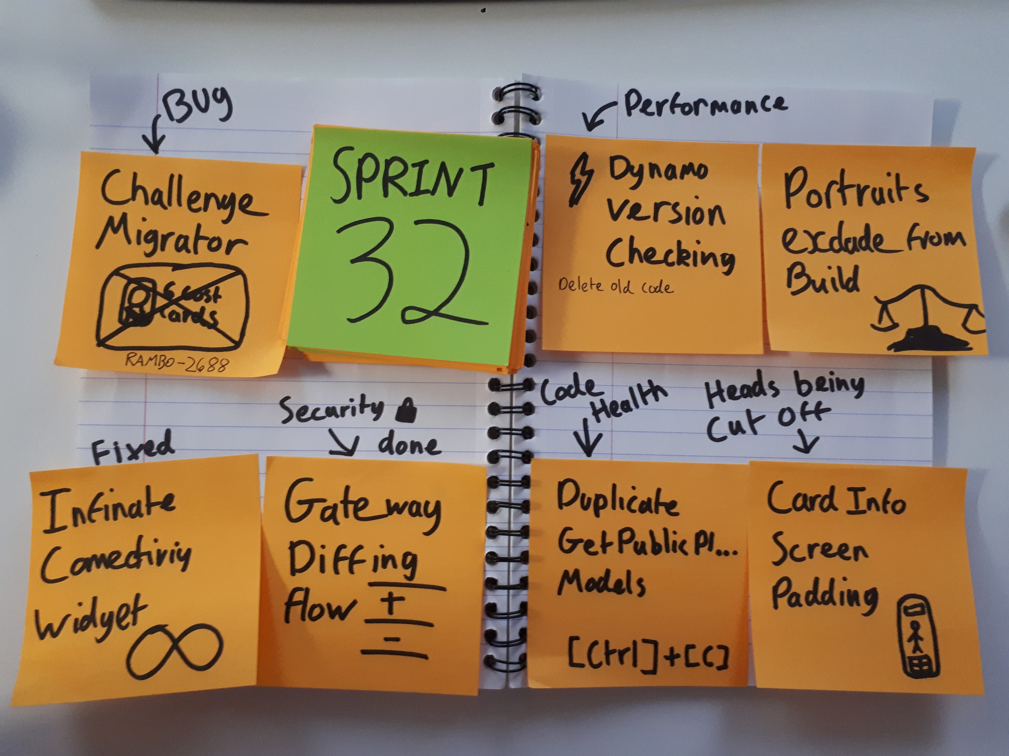
Retrospective Meetings
We have a lot of meetings…
“How has your sprint been?”
Happens at the end of the sprint
Show off what you’ve done
What went well/wrong
Notes:
At the end of a sprint; we have a retrospective meeting.
This is a really fun opportunity for us to share what we worked on this week. Make meme video edits of the features we implemented.
Unfortunately; these meme edits are under NDA. I wish I could have shown them.
It’s really rewarding to share what you have been working on for so long. Our retrospectives are normally the best part of the week. Immediately after the retrospectives (and sometimes during) we all grab a beer and sit round the sofas and chill out.
So now we have all of these meetings out of the way… Let’s see what a typical day looks like.

Slide 15
Daily Standup
We have a lot of meetings…
“How has your day been?”
Happens once a day at 10:30
Tell everyone what you are doing
Talk to people after Standup
Notes:
My days start with getting a little bit of work done in the morning.
We then have our “Daily Standup“ at 10:30.
It’s where we all stand in a circle and let each other know what we are doing for that day
and invite people to review your work, e.t.c.
“Hay, mark, I need a code review later.”
Or
“I’m having trouble with X area of code, if anyone has any experience with it I would appreciate some assistance.”
Ideally you ask your co-workers for help whenever you need it; but having daily standups allow everyone to ensure they always have a regular opportunity to communicate.

Slide 16
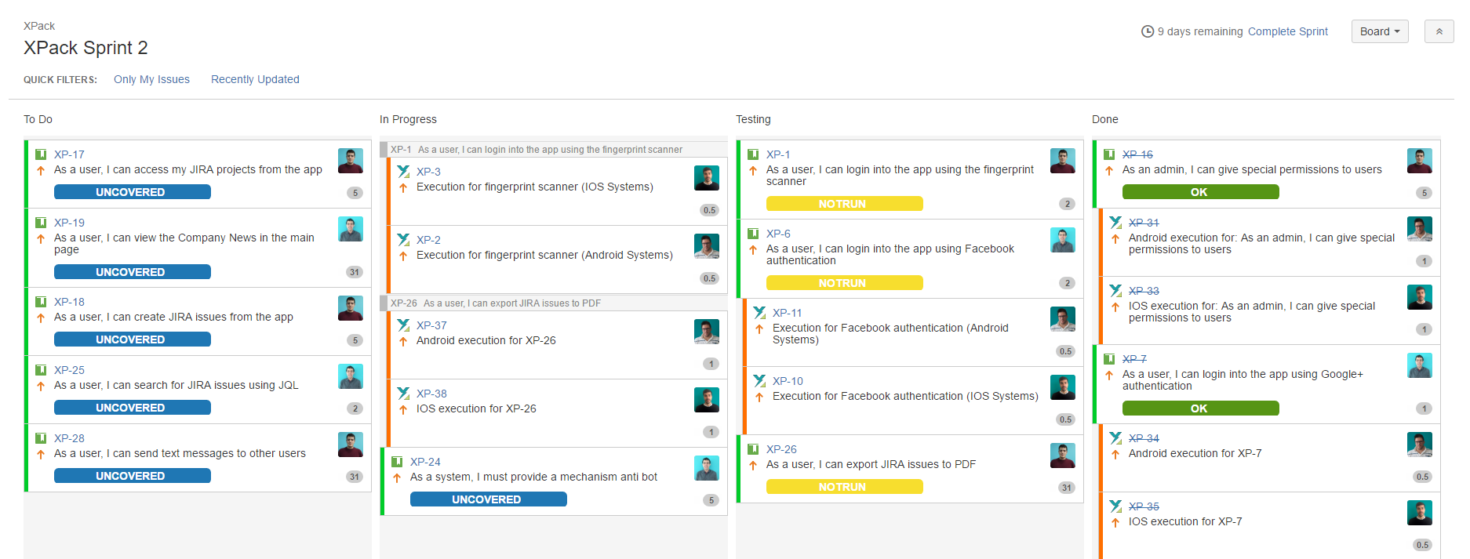
Sprint Board
Notes:
Now that I’m back from my daily stand-up, it’s time we get back to work.
If I’m ever lost and I don’t know what I’m working on; this is where I go. The sprint board. This will have all the tasks I should currently working on, and everything I need to get done for the sprint.
If it’s the first Monday of the 2-week sprints, I’ll spend the day fixing bugs. Having regular bug days stops the bugs from piling up and becoming too overwhelming.
Before a big release (about once every 2-3 months) we will dedicate a few days to just working through the bugs on that list. Sometimes even dedicating whole months to just bugs.

Slide 17
Back to Work!
What work is there to do?
Notes:
Alright, so what work is it that I do?
Well… My work can be divided into a few responsibilities.

Slide 18
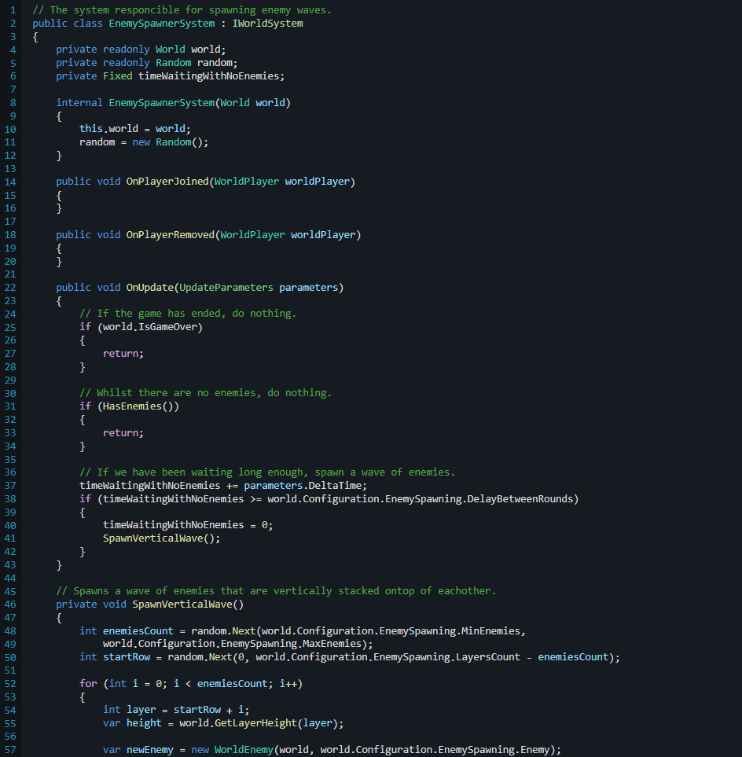
Back to Work!
What work is there to do?
Practical
Notes:
Lots of the work I do is practical; I will put my headset on and program non-stop for hours.
We even had a phrase at TT Odyssey that goes “headset-on work”; meaning to set aside time not to be disturbed so you can get lots of practical work done.
It's a good idea to get other people involved when your doing stuff like that so that other people can understand how it works and it stops you focusing too much on one thing.
You have to be careful to make sure your not over-engineering! I enjoy the amount of freedom I get when I’m writing systems from the ground up.
Not all of the practical work is so direct. We often employ Pair Programming to solve problems.

Slide 19
Notes:
I’m often reminded of this horrendous scene from NCIS where there’s two people typing on the same keyboard.
Pair programming is when two programmers are working on the same workstation at once to solve a problem. This is often helpful to spread information about a piece of code that you might be stuck on.
It’s nothing like NCIS hacking.

Slide 20
Back to Work!
What work is there to do?
Practical
Leadership
Notes:
Other times; I'm doing more leadership-orientated work.
It's a bit intimidating at first, but I really enjoy it.
There's industry juniors and veterans at my office who choose not to do leadership, and get on with the practical work instead; and there’s myself and some of my co-workers that like to take a big task off of the producers hands and delegate it to people.
Developers who take on these big tasks are often called “Feature Leads”. This person is expected to be the go-to person for that feature. If anyone has questions about that feature, they will direct them towards you.
I was the “Feature Lead” for Clans, Leaderboards, Ranked, and other game systems.
A feature lead is responsible for the feature they work on. It’s their job to make sure their feature meets deadlines for it’s development, testing, and release. If these deadlines aren’t being met; they need to let producers know ASAP.
Being a feature lead is a great way to get experience leading teams of programmers; and this opportunity is open to all programmers at TT Odyssey, regardless of title.
Feature Leads often have a spare chair at their desk for visitors. They get them a lot.

Slide 21
Back to Work!
What work is there to do?
Practical
Leadership
Mentoring
Notes:
Mentoring is such an important part of studio culture. Make this something that you look for in your future jobs; whether you go into games or software.
Having a studio culture that incorporates mentoring has been great for everyone at my office.
Everyone has someone to go to, and to talk to.
Every month, two people sit down with their mentors for a couple of hours and you can just have a pretty chilled conversation. They could be about the weather; what you where up to at the weekend; stuff that you encountered at work; it doesn’t matter.
Mentors are also a great person to go to when it comes to career goals.

Slide 22
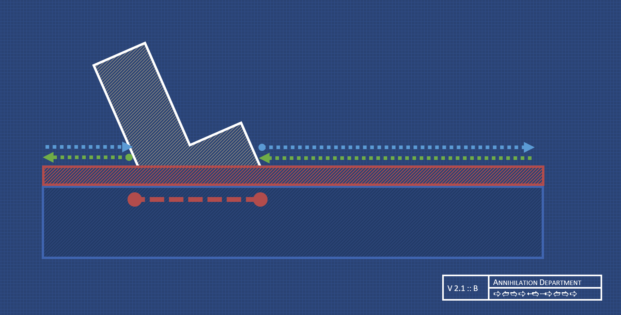
Back to Work!
What work is there to do?
Practical
Leadership
Mentoring
Planning and Theory
Notes:
I enjoy this part! The planning and theory!
At my office, a feature lead will take the Design Spec, sit down with the feature team (that’s the team the feature lead runs) and we present our plans to each other.
I enjoy this part because when it’s done right, it really shows. When it’s done wrong, it can have devastating effects on the project.
Design will ask for stuff. And if you do that stuff without understanding why you are doing that stuff; you might miss something fundamental.
We have a process called “Iterating on Design”. This can involve breaking the design spec into smaller parts; or completely change up the who design of the feature.
This is also an opportunity for people to voice their concerns with the design and contribute towards the design.

Slide 23
Back to Work!
What work is there to do?
Practical
Leadership
Mentoring
Planning and Theory
Ideas and Play Testing
Notes:
This is the “I can’t believe they are paying me to do this” kindof work.
Quite often we will all install the latest build onto a device and sit in our sofa area and just play the game.
It’s great fun competing against each other.
Lots of great ideas come from this.
We will often have the design team grab their notebooks and constantly be scribbling down notes during these play sessions.
We have separate teams working on different versions of the game.
Playing those versions and comparing them to the game that’s currently out in the world is really exiting.
Look out for studios that make play testing a regular part of the studio work. This is something you want to be able to get involved with as much as possible. It’s a really good sign that a studio is passionate about their product.

Slide 24
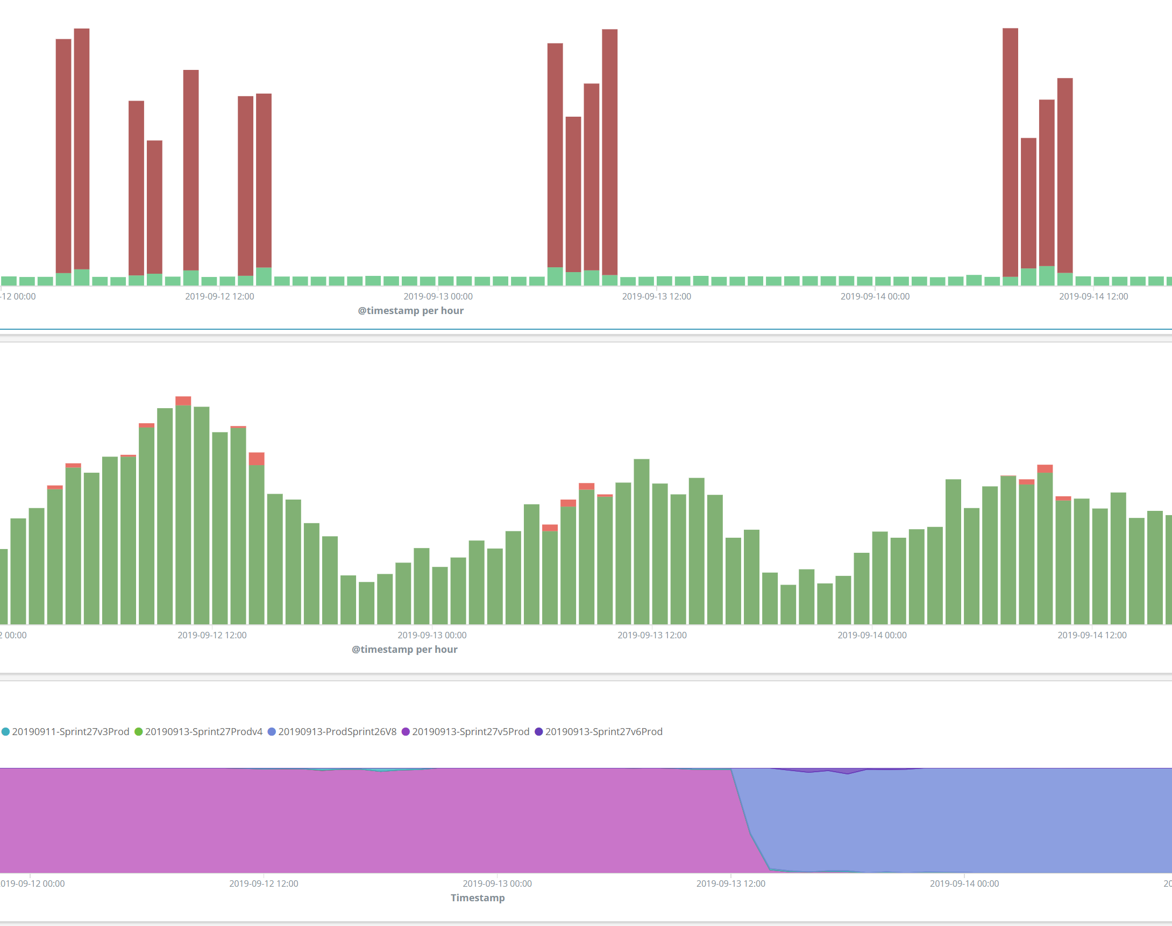
Back to Work!
What work is there to do?
Practical
Leadership
Mentoring
Planning and Theory
Ideas and Play Testing
Live Ops
Notes:
LiveOps is a responsibility that only myself and 2 other people have at TT Odyssey. That’s the responsibility of my team, the Server Team.
LiveOps is maintaining our live servers.
It’s checking the logs to make sure there’s no errors.
And it’s being one of the 3 people at the studio who can actually fix the servers if something goes wrong.
That screenshot is from our logs; from our live servers; which would occasionally encounter these periods of 500 errors.
I never solved what caused this bug. It haunts me in my dreams.
LiveOps does mean there’s a change you’re getting called at 2am if an alarm is triggered. That hasn’t happened yet, though!

Slide 25

Back to Work!
What work is there to do?
Practical
Leadership
Mentoring
Planning and Theory
Ideas and Play Testing
Live Ops
Interviewing
Notes:
When TT Odyssey was recruiting, something that I also done was resume screening and interviews.
It taught me a lot about what makes a good resume.
What we did is we sat down with a highlighter and go through it, picking out the key facts. University, experience, relevant skills, e.t.c. And then we write down some notes.
We then presented the resume we had been reading to the rest of the team in the meeting room.
Given that…

Slide 26
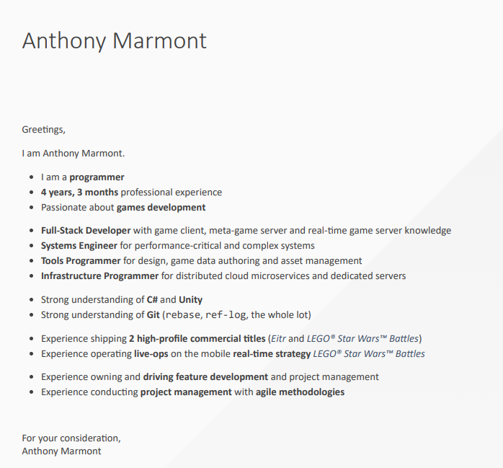
My Cover Letter
I’m not saying it’s good!
After going through a lot of CVs, I found that this really helps!
Experiment and find out what works for you. Everyone has unique experience.
Tailored to the job posting
Notes:
I have seen a lot of resumes now.
I’ve highlighted a lot of the same words.
From my experience, something like is pretty helpful. This is what my cover-letter now looks like. It’s everything that I would sit down and highlight right on the front.
Since it’s my cover letter, I can also tailor some of the key points to the job from the job posting.
And I know there’s no risk of someone missing something when they go through with a highlighter.
Every time I’ve handed in this CV; I’ve got a response; but this is still very-much work in-progress stuff for me.
My biggest piece of advice when it comes to CVs: DON’T RATE YOUR SKILLS. Don’t do fancy bars where you rate your skills our of 10. I can talk in detail more about why; but I think instead I’ll just share what happened to a poor candidate who did. I was interviewing applicants for a Grads in Games award and one applicant rated their skills. Upon entering the interview room; the former Apple Tech Director sitting next to me tore their CV up in-front of them (and proceeded to bluntly ask “Why should I hire you?”.)

Slide 27
Back to Work!
Responsibilities
Practical
Leadership
Mentoring
Planning and Theory
Ideas and Play Testing
Live Ops
Interviewing
In summary
Meetings
Pointing Meetings
Triage Meetings
Retrospectives
Daily Standups
Notes:
I hope you have learnt more about what it means to be in Games Development.
There is so much more to Games Development (and Software Engineering as a whole) than just the programming.
And I hope you explore potential careers with the industry in the future.
It’s not all grind and crunch. If you want advice on how to avoid studios who do use crunch, hit me up on Twitter. I could do a whole talk on that.
Feel free to hit me up on Twitter if you want to a CV reviewed. I may be able to show you what it’s like for a recruiter to review your CV. Don’t worry; I won’t tear it up in front of you. Even if you rated your skills.

Slide 28
Questions?
Fire Away!
Anthony “Fydar” Marmont
(they/them)
@Fydarus
Fydar
Notes:
Unfortunately, I don’t know any inside details from ‘Star Citizen’.
If you follow the Reddit, you know more than me.
I find out about new planets being released by Googles News

